Slide 1
The ‘New’ Self-as-context Russ Harris
ACT World Conference 2013
Present Moment
Acceptance
Values
Psychological
Flexibility
Defusion
Committed Action
Self-as-context
1
Notes:
Robyn’s exercise to day 1 – bull’s eye to day 2

Slide 2
HEAR
SEE
TOUCH
FEELINGS
TASTE
THOUGHTS
SMELL
PAIN
MEMORY
FEELING
SENSATION
THOUGHT
SULTANA
Notes:
Pleasant memory – pleasant feeling
Unpleasant memory form the last week – unpleasant feeling

Slide 3
Self-as-context: ‘new’ definition
W T F ??!!!
Hayes, 2011:
“Self-as-context is the coming together and flexible social extension of a cluster of deictic relations (especially I/here/now) that enable observation and description from a perspective or point of view.

Slide 4
Self-as-context: ‘new’ definition
“Flexible Perspective Taking”
Ability to observe and describe from a perspective or point of view
enables or facilitates many different experiences,
including theory of mind, empathy, compassion, self-compassion, acceptance, defusion ….
and a transcendent sense of self (often called ‘the observing self’).

Slide 5
A bit of RFT

Slide 6
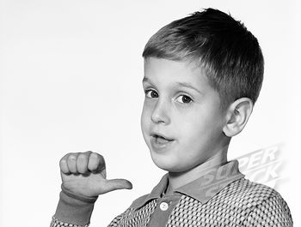
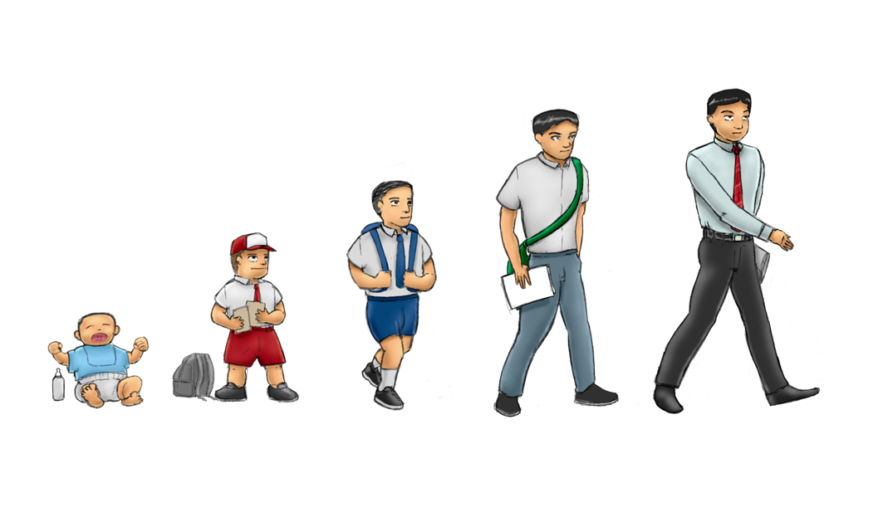
“I”
“You”
“Here”
“There”
“Now”
“Then”
DEICTIC FRAMING

Slide 7
“What are you doing here?”
“What am I doing here?”
“ What were you doing there?”
“What was I doing there?”
“What are you doing now?”
“What am I doing now?”
“What were you doing then?”
“What was I doing then?”
The only constants?
I
Here
Now
Notes:
The child learns to relate her own behavior as different from that of others by learning three key relations which are “I versus YOU”, “HERE versus THERE” and “NOW versus THEN”.
She learns to respond appropriately to questions such as ‘What are YOU doing HERE?’, ‘What am I doing NOW?’, ‘What was I doing THEN?’ etc.
She will gradually learn to respond appropriately to these questions and as she does so she will see that whenever she is asked about her own behavior she always answers from the point of view of ‘I’, ‘HERE’ and ‘NOW’ and that this perspective is consistent and different from that of other people.
For example, if you ask me about my behavior, I will always answer from the position of ‘I’, ‘HERE’ and ‘NOW’ in response to your question asked by YOU, THERE (where you are) and THEN (when you asked – a few seconds ago).
I is always from this perspective here, not from someone else's perspective there
A sense of perspective is therefore abstracted through learning to talk about one's own perspective in relation to other perspectives

Slide 8
Perspective Taking Skills
YOU
HERE
NOW
I
THERE
THEN
Slide Courtesy of Steve Hayes

Slide 9
Self-as-Context
‘Flexible Perspective Taking’
The ‘locus’ of consciousness: everything is noticed from a perspective of ‘I, here, now’
Slide Courtesy of Steve Hayes

Slide 10
CONTACTING THE PRESENT MOMENT
I, here, now notice WHAT I see, hear, touch, taste, smell, think, feel, do
SELF-AS-PROCESS
I, here, now notice THAT I see, hear, touch, taste, smell, think, feel, do
DEFUSION
I, here, now notice my thoughts and see them as words and pictures
COMPASSION
I, here, now notice suffering and respond
with kindness
Self-as-Context
ACCEPTANCE
I, here, now notice my thoughts and feelings and allow them to be as they are
EMPATHY
I, here, now notice what someone else is feeling and feel it too
TRANSCENDENT SELF
or OBSERVING SELF
I, here, now notice THAT I am continuous, unchanging, distinct from, & more than WHAT I see, hear, touch, taste, smell, think, feel, do
COMMITTED ACTION
I, here, now notice my actions and take control of them
VALUES
I, here, now notice what is important and meaningful to me and put it into words

Slide 11
TEA
WATER ……… plus tea leaves
MILK
WATER………. plus various fats, proteins & sugars
Water
ORANGE JUICE
WATER …….. plus
bits of orange
BEER
WATER ……. plus beery stuff
COFFEE
WATER…….. plus coffee bean extracts

Slide 12
Self-as-context
All current ACT Books (except one) have the ‘old’ definition:
Self-as-context is the observing or transcendent self; i.e. they are synonymous
But is water synonymous with tea?
To make tea, we add stuff to water
To ‘make’ an experience of the observing or transcendent self, we add stuff to S-A-C

Slide 13
Self-as-context …. plus what?
To experience observing/transcendent self:
Deictic framing (S-A-C)
I, here, now notice
Plus
THAT ‘I’ am (or ‘a part of me’ is)
Frame of distinction
distinct from
Plus
WHAT I see, hear, touch, taste,
smell, think, feel, do
Hierarchical frame
and there is more to ‘me’ than
these thoughts, feelings, sensations
actions and body parts
Plus
Temporal frame
and ‘I’ (or ‘the part of me that notices’)
am continuous & unchanging
whereas thoughts, feelings, sensations,
actions and body parts constantly change

Slide 14
CONTACTING THE PRESENT MOMENT
I, here, now notice WHAT I see, hear, touch, taste, smell, think, feel, do
SELF-AS-PROCESS
I, here, now notice THAT I see, hear, touch, taste, smell, think, feel, do
DEFUSION
I, here, now notice my thoughts and see them as words and pictures
COMPASSION
I, here, now notice suffering and respond
with kindness
Self-as-Context
ACCEPTANCE
I, here, now notice my thoughts and feelings and allow them to be as they are
EMPATHY
I, here, now notice what someone else is feeling and feel it too
TRANSCENDENT SELF
or OBSERVING SELF
I, here, now notice THAT I am continuous, unchanging, distinct from, & more than WHAT I see, hear, touch, taste, smell, think, feel, do
COMMITTED ACTION
I, here, now notice my actions and take control of them
VALUES
I, here, now notice what is important and meaningful to me and put it into words

Slide 15
“Notice X”
Contact with the Present Moment = notice WHAT you see, hear, touch, taste, smell, think, feel, do
Self-as-process = notice THAT you are seeing, hearing, touching, tasting, smelling, thinking, feeling, doing …
… and noticing
Observing/transcendent self = notice THAT you are noticing…
… and that the you (or ‘part of you’) which notices is continuous, unchanging, distinct from, more than WHAT you see, hear, touch, taste, smell, think, feel, and do
Self-as-context = flexibly noticing from a perspective of I, here, now (i.e. flexible perspective taking)

Slide 16
Self-as-context = flexible perspective taking
Able to take perspective on ‘self’ (i.e. ongoing stream of thoughts, feelings, actions)?
‘Self-as-process’
Able to take perspective on self-story?
Defusion from the ‘conceptualized self’
Able to take perspective on one’s own noticing?
Transcendent or observing self
Able to imagine perspective of another?
Empathy, Theory of Mind

Slide 17
The ‘Observing Self’: why bother?
Aids defusion – especially from conceptualised self
Aids acceptance, willingness, and formal exposure: a ‘safe place’ inside you
Important aspect of spirituality
For survivors: a part of you was unharmed
Sense of stability amidst the chaos of life
NB: 1 & 2 are easily achieved through defusion & acceptance skills without need for explicit ‘observing self’ exercises.

Slide 18
Observing Self
Two Simple interventions:
Notice X - and be aware you’re noticing
Stage show metaphor

Slide 19
Notice your breath (10 seconds pause)
Be aware you’re noticing (10 seconds pause)
Notice what you’re thinking ...
Be aware you’re noticing ...
Notice what you can hear ....
Be aware you’re noticing ....
Notice what your mind is telling you ...
Be aware you’re noticing ....
Notice what you can feel in your feet ....
Be aware you’re noticing ....
Notice what thoughts you’re having ....
Be aware you’re noticing ...
So there’s a part of you that notices everything
Optional: Life is like a stage show … and on that stage are all your thoughts and feelings and everything you can see, hear, touch, taste and smell … and there’s a part of you that can step back and watch the show
Notes:
Practice in pairs

Slide 20
Self-Acceptance
You are not who you think you are!
If your mind tells you a negative story …
‘Thanks, mind!’
And if it’s a positive story …
‘Thanks, mind!’
=>The ‘Good self/Bad Self’ exercise
Notes:
Documentary of Africa

Slide 21
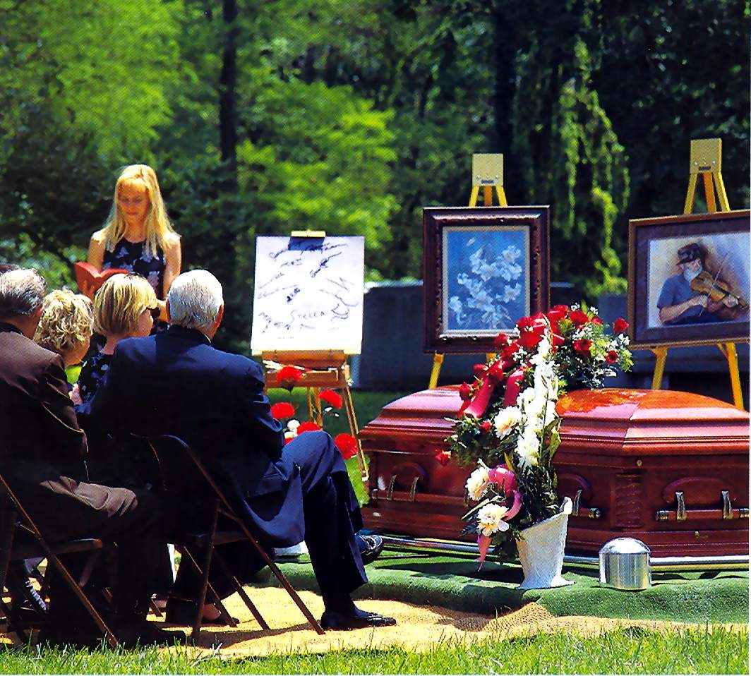
Self-Acceptance
So who am I?
She was so caring, loving, kind. Always there for me when I needed her!
She had a really high opinion of herself!
You are one being:
Physical self (body)
Thinking Self (mind)
& Observing Self
Notes:
Documentary of Africa

Slide 22
The Conceptualised Self
Your ‘conceptualised self’ is important and often useful. You wouldn’t want to get rid of it
You may even want to work on developing it
But hold it lightly – it is not you!
=>The ‘I am’ exercise
Notes:
Documentary of Africa

Slide 23
The Observing Self
A container
A space
A perspective
An Experience ‘beyond words’

Slide 24
Common Adjectives
Spacious
Expansive
Silent
Invisible
Formless
Groundless
Without borders
Ever present
Unchanging
Clear
Pure

Slide 25
The Observing Self is AKA ..
The observer self
The noticing self
The continuous ‘you’
The transcendent self
The silent self (or witness)
Self-as-perspective
The ‘I’ (or ‘you’) that notices
Spacious awareness
Pure awareness
Pure consciousness

Slide 26
3 Types of Intervention
Metaphors
Notice that you’re noticing
Defusion from self-story

Slide 27
Useful Metaphors
Watching a stage show
The Documentary of you
Sky & weather
Chessboard
Lantern in the dark
House & Furniture

Slide 28
How To Introduce ‘Observing Self’
In many ACT protocols, comes after defusion/acceptance/ present moment
‘So you’ve been doing all these mindfulness exercises – noticing thoughts, noticing feelings, noticing your breath etc. What is this part of you that does all the noticing?’

Slide 29
How To Introduce ‘Observing Self’
But good to plant seeds early, even from first session:
‘As you notice x, be aware you’re noticing’.
‘There’s x – and there’s a part of you noticing x’
‘Life is like a stage show ….’

Slide 30
Brief Observing Self Exercise 1
Close your eyes. Notice: where are your thoughts? Above you, behind you, in front of you, to one side? Inside your head or body?
Are they pictures, words or sounds? Moving or still? What speed & what direction?
So your thinking self is generating thoughts – and another part of ‘you’ is noticing them
The thoughts keep changing. But the ‘you’ that notices them does not change.
This gets your mind whirring/ debating/ analyzing – so let’s do that again. Notice: where are your thoughts? (Repeat as needs)

Slide 31
Brief Observing Self Exercise 2
Notice how you’re sitting (5 secs)
Notice what you can see (5 secs)
Notice what you can smell and taste (5 secs)
Notice what you can hear (5 secs)
Notice what you’re thinking (5 secs)
Notice what you’re feeling (5 secs)
Notice what you’re doing (5 secs)
There’s a part of you in there notices everything you see, hear, touch, taste, smell, think, feel, or do … is it good, bad, or ‘just there’?

Slide 32
‘Not This, Not That’ Exercise
Observe X
There is X; there ‘you’ are observing X
If you can observe X, you cannot be X
X continually changes; the ‘you’ that observes X does not change
X = Breath/thoughts/body/feelings/roles
To emphasize the ‘continuous’ nature of you, add in memories: The ‘you’ that observes was there at the time.

Slide 33
Who Are You?
Q: Who are you?
R: I am …
Q: Thank you. (pause). Who are you?
R: I am …
To finish off, R says: ‘I just am’

Slide 34
Let Yourself Go
Bring to mind an image and some words that represent your:
a) Professional self; b) Suffering self; c) Strong self
Observe this image and these words
If you can observe this image and these words, you cannot be this image and these words
Knowing this, let it go …for now
When it comes back, hold it lightly

